Slide 1
Project Time Management
BAI3020 Project Management
Notes:
Project Time Management is about:
Quantifying project objectives
Defining significant events and activities
Determining sequence for activity accomplishments
Establishing a time frame for activity accomplishments
Establishing a basis for performance evaluation
Allowing logical decisions for project: continuation, acceleration, redirection, limitation and change of scope

Slide 2
Importance of Project Schedules
Managers often cite delivering projects on time as one of their biggest challenges
Time has the least amount of flexibility; it passes no matter what happens on a project
Schedule issues are the main reason for conflicts on projects, especially during the second half of projects

Slide 3
Project Time Management Processes
Defining activities: identifying the specific activities that the project team members and stakeholders must perform to produce the project deliverables
Sequencing activities: identifying and documenting the relationships between project activities
Estimating activity resources: estimating how many resources a project team should use to perform project activities

Slide 4
Project Time Management Processes
Estimating activity durations: estimating the number of work periods that are needed to complete individual activities
Developing the schedule: analyzing activity sequences, activity resource estimates, and activity duration estimates to create the project schedule
Controlling the schedule: controlling and managing changes to the project schedule

Slide 5
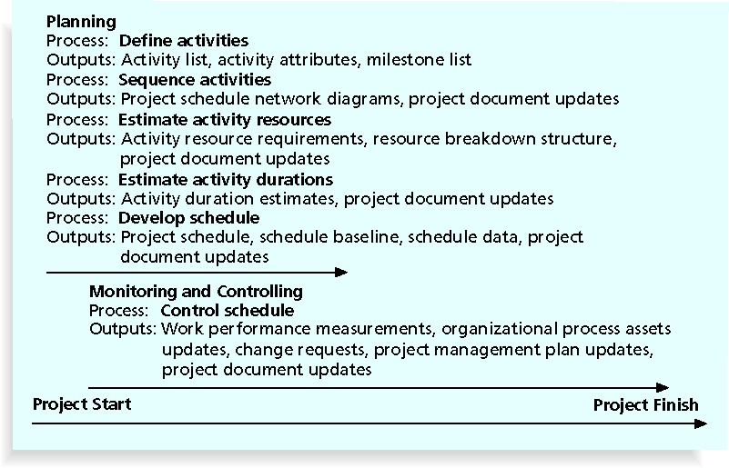
Project Time Management Summary

Slide 6
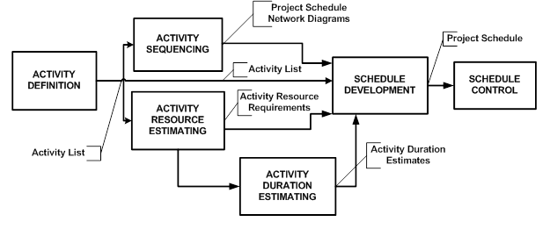
Project Time Management
PROJECT TIME MANAGEMENT PROCESS
AND HOW THEY ALL PIECE TOGETHER

Slide 7
6.1 Define Activities
Project Time Management
Inputs
1 Scope baseline
Tools & Techniques
1 Decomposition
Outputs
1 Activity list
2 Activity Attributes
3 Milestone
2 Rolling wave planning
2 Enterprise environmental factors
3 Organizational process assets
Templates
Expert judgment
Notes:
Define Activities is the process of identifying the specific actions to be performed to produce the project deliverables.
The Create WBS process identifies the deliverables at the lowest level in the WBS, the work package. Work packages are typically decomposed into smaller components called activities. These represent the work necessary to complete the work package.
Inputs
.1 scope baseline
The project deliverables, constraints and assumptions documented in the project scope baseline
.2 enterprise environmental factors
Influence the Define Activities process
.3 OPA
Formal and informal activity planning-related policies, procedures and guidelines (scheduling methodology)
Lessons-learned, historical information
Tools and Techniques
.1 decomposition
Involves subdividing the project work pack ages into smaller, more manageable components called activities.
Represents the effort needed to complete the work package
WBS and WBS dictionary can be developed either sequentially or concurrently
.2 rolling wave planning
Is a form of progressive elaboration planning where the work to be accomplished in the near term is planned in detail and future work is planned at a higher level of the WBS.
.3 templates
standard activity list or a portion of an activity list from previous project is often usable as a template for new projects.
Templates can also be used to identify typical schedule milestones.
.4 expert judgment
Who are experienced and skilled
Outputs
.1 activity list
Comprehensive list including all schedule activities required on the project. Includes the activity identifier and a scope of work description.
.2 activity attributes
Extend the description of the activity by identifying the multiple components associated with each activity. The components for each activity evolve over time.
The Activity ID, WBS ID and Activity name will be included.
.3 milestone list
Significant point or event in the project, point in time assessment, start of project, key meetings and installation dates

Slide 8
Defining Activities
An activity or task is an element of work normally found on the work breakdown structure (WBS) that has an expected duration, a cost, and resource requirements
Activity definition involves developing a more detailed WBS and supporting explanations to understand all the work to be done so you can develop realistic cost and duration estimates

Slide 9
Activity Lists and Attributes
An activity list is a tabulation of activities to be included on a project schedule that includes:
The activity name
An activity identifier or number
A brief description of the activity
Activity attributes provide more information such as predecessors, successors, logical relationships, leads and lags, resource requirements, constraints, imposed dates, and assumptions related to the activity

Slide 10
Milestones
A milestone is a significant event that normally has no duration
It often takes several activities and a lot of work to complete a milestone
They’re useful tools for setting schedule goals eg. installation dates, Project Start, Key meetings and also to monitoring progress
Examples include obtaining customer sign-off on key documents or completion of specific products

Slide 11
What Went Wrong?
At the U.S. Federal Bureau of Investigation (FBI), poor time management was one of the reasons behind the failure of Trilogy, a “disastrous, unbelievably expensive piece of vaporware, which was more than four years in the (un)making. The system was supposed to enable FBI agents to integrate intelligence from isolated information silos within the Bureau.”*
In May 2006, the Government Accounting Agency said that the Trilogy project failed at its core mission of improving the FBI’s investigative abilities and was plagued with missed milestones and escalating costs
*Roberts, Paul, “Frustrated contractor sentenced for hacking FBI to speed deployment,”
InfoWorld Tech Watch, (July 6, 2006).

Slide 12
6.2 Sequence Activities
Project Time Management
Inputs
1 Activity list
Tools & Techniques
1 Precedence diagramming method (PDM)
Outputs
1 Program schedule network diagrams
2 Activity Attributes
3 Milestone
4 Project scope statement
5 Org. process assets
2 Project document updates
2 Dependency determination
3 Applying leads and lags
4 Schedule network templates
Notes:
Sequencing activities focuses on arranging the activities in the most efficient and effective order
Note: the inputs for sequencing activities are the outputs from defining the activities in 6.1
Process of identifying and documentation relationships among the project activities. Activities are sequenced using logical relationships. Every activity and milestone except the first and last are connected to at least one predecessor and one successor. Lead or lag time between activities to support a realistic and achievable project schedule.
Inputs
.1 activity list
.2 activity attributes
May describe a necessary sequence of events or defined predecessor or successor relationships.
.3 milestone list
May have scheduled dates for specific milestones
.4 project scope statement
Product scope description, includes product characteristics
Generally reviewed for accuracy
.5 OPA
May include: project files, corporate knowledge base, scheduling methodology
Tools and Techniques
.1 precedence diagramming method (PDM)
PDM is a method used in Critical Path Methodology CPM for constructing a project schedule network diagram.
Also called Activity-On-Node (AON)
Four dependencies or logical relationships
Finish-to-start – the initiation of the successor activity depends on the completion of the predecessor activity.
Finish-to-finish – the completion of the successor activity depends upon the completion of the predecessor activity.
Start-to-start – the initiation of the successor activity depends upon the initiation of the predecessor activity
Start-to-finish – the completion f the successor activity depends upon the initiation of the predecessor activity.
Finish-to-start is most common and start-to-finish is rarely used.
.2 dependency determination
Three types:
Mandatory dependencies – that are contractually required or inherent in the nature of the work. Determines which dependencies are mandatory during the process of sequencing the activities. Mandatory dependencies often involve physical limitations. Mandatory dependencies are also sometimes referred to as hard logic.
Discretionary dependencies – are sometimes referred to as preferred logic, preferential logic or soft logic.
Are established based on knowledge of best practices within a particular application area.
Should be fully documented since they can create arbitrary total float values and can limit later scheduling options.
When fast tracking they should be reviewed and considered for modification or removal.
External dependencies – involve a relationship between project activities and non-project activities. They are outside of the teams control.
.3 applying leads and lags
Dependencies that may require a lead or a lag to accurately define the logical relationship. Leads and lags should not replace schedule logic.
Lead – allows an acceleration of the successor activity
Lag – directs a delay in the successor activity
.4 schedule network templates
Portions of a project schedule network diagram are often referred to as sub network or fragment network.
Templates are especially useful when a project includes several identical or early identical deliverables.
Outputs
.1 project schedule network diagrams
Schematic displays of the project’s schedule activities and logical relationships among them are also referred to as dependencies.
.2 project document updates
Activity lists
Activity attributes
Risk register

Slide 13
Sequencing Activities
Involves reviewing activities and determining dependencies
A dependency or relationship is the sequencing of project activities or tasks
You must determine dependencies in order to use critical path analysis

Slide 14
Three types of Dependencies
Mandatory dependencies: inherent in the nature of the work being performed on a project, sometimes referred to as hard logic
Discretionary dependencies: defined by the project team; sometimes referred to as soft logic and should be used with care since they may limit later scheduling options
External dependencies: involve relationships between project and non-project activities

Slide 15
Network Diagrams
Network diagrams are the preferred technique for showing activity sequencing
A network diagram is a schematic display of the logical relationships among, or sequencing of, project activities
Two main formats are the arrow and precedence diagramming methods

Slide 16
Arrow Diagramming Method (ADM)
Also called activity-on-arrow (AOA) network diagrams
Activities are represented by arrows
Nodes or circles are the starting and ending points of activities
Can only show finish-to-start dependencies

Slide 17
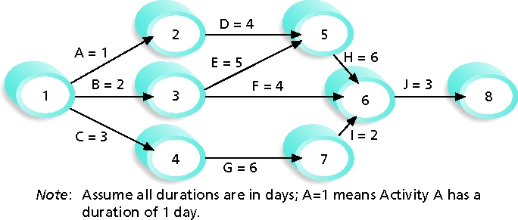
Activity-on-Arrow (AOA) Network Diagram for Project X

Slide 18
Precedence Diagramming Method (PDM)
Activities are represented by boxes
Arrows show relationships between activities
More popular than ADM method and used by project management software
Better at showing different types of dependencies

Slide 19

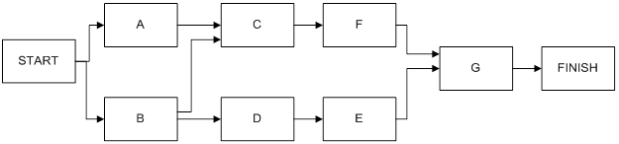
Precedence Diagramming Method (PDM)- Sample or Activity-on-Node
Task Dependencies shown by lines
Notes:
Activity on the Node
Activity on the node uses the lines to show dependencies and the Node to present the details for the activity being conducted.
A JOB OR ACTIVITY Represented in Network Diagram as represented by a box which is called a node. So node in this diagram represents the actual activity performed.
A PROJECT Represented in Network Diagram as the Network
AN EVENT Represented in Network Diagram as the end of the arrows shown on the chart.
The Line which can be presented in a normal weight or bold (red) to identify those activities that are on the critical path. This is to assist the project manager in identifying which tasks when shortened or lengthened will effect the duration of the overall project.
For the balance of this log we will be using the Activity on the Node Method. We have chosen this approach as most of the Project Management tools use Activity on the Node.
The Dummy Activity that is used in those cases where two or more activities must be completed prior to the commencement of the next activity. The dummy is introduced so that each activity can be defined by a unique combination of the start and end node. This is represented as a dotted line.

Slide 20
Task Dependencies
What other jobs must be completed before this starts
What other jobs can be done at the same time
What other jobs cannot start before this job finishes
Notes:
Task Dependencies
Since the network is intended to represent only the sequential relationship and not the length of time taken, the length of the arrow and its direction are not significant. It is, however, a convention to list nodes and their associated dependencies from left to right, top to bottom. In order to define the dependencies it is necessary to ask the following three questions:
• What other jobs must be complete before this one can start?
• What other jobs can be done at the same time?
What other jobs cannot start until this one is finished?

Slide 21
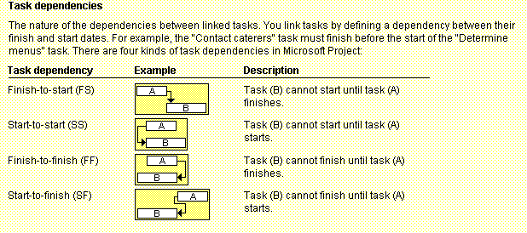
Task Dependency Types

Slide 22
Network Diagram- Sample
Notes:
The following points are not fundamental requirements but are intended as useful hints for drawing of a network:
After a little practice it should be possible to produce a finished diagram at the first attempt. Do not draw a network in “rough” with the intention of redrawing or tracing later.
Draw on tracing paper using a medium pencil so that alterations are easy, and prints can be made.
When starting on a large project, start at the front or left end of a long roll of paper and do not try to condense the network too much.
If two people are working together on the same project, one should continually check the work of the other by questioning his decisions on logic.
It is usual to start with a single activity called “start” and end with one called “finish”.
When a network is originally prepared it should be drawn on the basis of unlimited resources, so that non-essential sequential relationships are not built into the network. Since it is not practical to execute a project in this way it may be necessary at some stage to put certain activities requiring the same resource in sequence; this should NOT be done initially but only when the time relationship between these activities has been established.
Set out the network in bands or zones according to separate trades or areas of work.

Slide 23
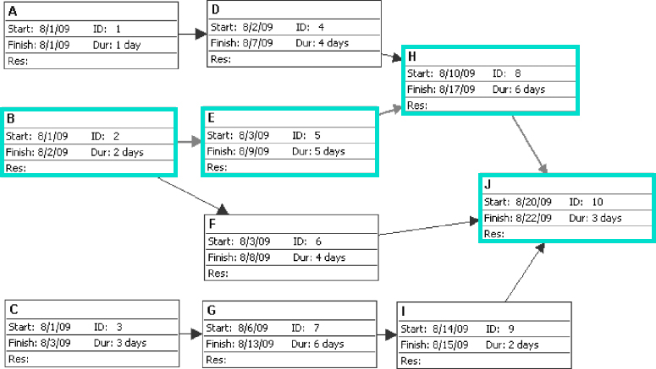
PDM Network Diagram

Slide 24
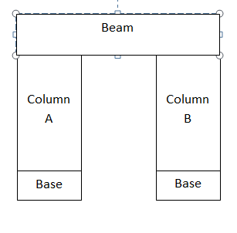
Building an Arch Exercise 1
Project Time Management
TASK ACTIVITY
Clear Site (start)
Prepare Base A
Prepare Base B
Erect Column A
Erect Column B
Erect Bean
Plumb and Line Structure
Grout Base (finish)
Notes:
Prepare a Network Diagram to Build this simple structure. Draw it in the space provided on the slide
Consider firstly the job of clearing the site.
We ask the three questions:
no other job need be complete first,
no other job can be done at the same time, and
all other jobs cannot start until this is complete.
It is then clearly the first Node to draw and must precede all others.
We then look to see which job can now start.
The same rigorous questioning of all activities enables us to complete the diagram.
Although this example is extremely simple, it illustrates the main points:
The strict logic of one job following another.
A job is dependent only on the jobs that must precede it; not also on jobs which may precede it.
The importance of an understanding of the project.

Slide 25
Building an Arch Exercise 1 Solution
Project Time Management
2
4
1
6
7
8
3
5

Slide 26
Network Diagram: Exercise 2
Project Time Management
Notes:
In the area provide below the slide draw out the Network Diagram.

Slide 27
Network Exercise 2 Solution
Project Time Management
B
C
A
E
D

Slide 28
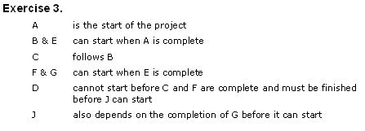
Network Exercise 3
Notes:
In the area provide below the slide draw out the Network Diagram.
The following points are not fundamental requirements but are intended as useful hints for drawing of a network:
After a little practice it should be possible to produce a finished diagram at the first attempt. Do not draw a network in “rough” with the intention of redrawing or tracing later.
Draw on tracing paper using a medium pencil so that alterations are easy, and prints can be made.
When starting on a large project, start at the front or left end of a long roll of paper and do not try to condense the network too much.
If two people are working together on the same project, one should continually check the work of the other by questioning his decisions on logic.
It is usual to start with a single activity called “start” and end with one called “finish”.
When a network is originally prepared it should be drawn on the basis of unlimited resources, so that non-essential sequential relationships are not built into the network. Since it is not practical to execute a project in this way it may be necessary at some stage to put certain activities requiring the same resource in sequence; this should NOT be done initially but only when the time relationship between these activities has been established.
Set out the network in bands or zones according to separate trades or areas of work.

Slide 29
Network Exercise 3 Solution
B
C
D
A
F
E
J
G

Slide 30
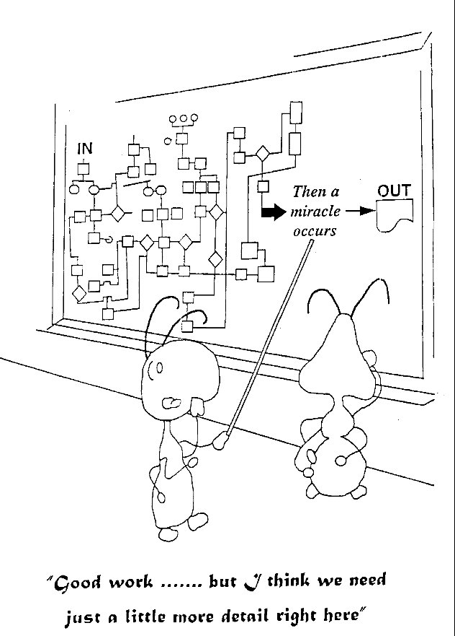
Project Time Management

Slide 31
6.3 Estimate Activity Resources
Project Time Management
Inputs
1 Activity list
Tools & Techniques
1 Expert judgment
Outputs
1 Activity resource requirements
2 Activity Attributes
3 Resource calendars
4 Enterprise environmental factors
5 Organizational Process assets
2 Alternatives analysis
3. Published estimating data
4 Bottom-up estimating
5 Project management software
2 Resource breakdown structure
3 Project document updates
Notes:
Process of estimating the type and quantities of material, people, equipment or supplies required to perform each activity. Closely coordinated with Estimate Costs process.
Inputs
.1 activity list
Identifies the activities
.2 activity attributes
Provide the primary data input for use in estimating those resources required.
.3 resource calendars
Information on which resources are potentially available during planned activity period.
Resource calendars specific when and how long identified project resources will be available during the project.
This information may be at the activity or project level.
Consideration of attributes such as experience, skill level and geographical locations must be considered
Composite resource calendars include availability, capabilities and skills of human resources.
.4 EEF
Can include resource availability and skill
.5 OPA
Policies, procedures regarding staffing
Policies, procedures relating to rental and purchase of supplies and equipment
Historical information
Tools and Techniques
.1 expert judgment
Assess the resource-related inputs to this process. Person with specialized knowledge in resource planning and estimating
.2 alternatives analysis
Schedule activities have alternative methods of accomplishment
.3 published estimating data
Publish updated production rates and unit costs of resources
.4 bottom-up estimating
Cannot be estimated with a reasonable degree of confidence, the work within the activity is decomposed into more detail. They are then aggregated into total quantity for each of the activity’s resources.
.5 project management software
The capability to help plan, organize, and manage resource pools and develop resource estimates.
Outputs
.1 activity resource requirements
Process identifies the types and quantities of resources required for each activity in a work package. These requirements can then be aggregated to determine the estimated resources for each work package.
.2 resource breakdown structure
Hierarchical structure of the identified resources by resource category and resource type.
.3 project document updates
Activity list
Activity attributes
Resource calendars

Slide 32
Estimating Activity Resources
Before estimating activity durations, you must have a good idea of the quantity and type of resources that will be assigned to each activity; resources are:
people
Equipment
Materials
Consider important issues in estimating resources
How difficult will it be to do specific activities on this project?
What is the organization’s history in doing similar activities?
Are the required resources available?
A resource breakdown structure is a hierarchical structure that identifies the project’s resources by category and type

Slide 33
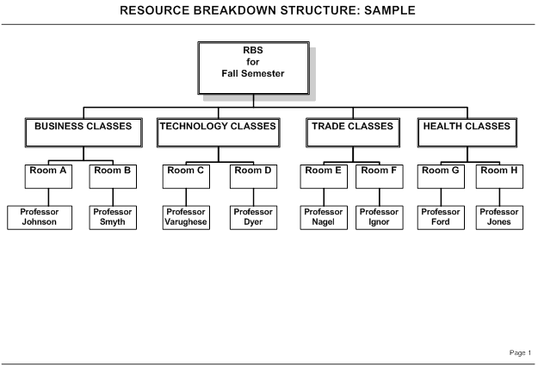

Slide 34
6.4 Estimate Activity Durations
Project Time Management
Inputs
1 Activity list
Tools & Techniques
1 Expert judgment
Outputs
1 Activity duration estimates
2 Activity Attributes
3 Activity Resource Requirements
5 Project scope statement
7 Organizational Process assets
2 Analogous estimating
3. Parametric estimating
4 PERT 3-point estimates
5 Reserve analysis
2 Project document updates
4 Resource calendars
6 Enterprise environmental factors
Notes:
Process of approximating the number of work periods needed to complete individual activities with estimated resources.
Estimating activity durations uses information on activity scope of work, required resources types, estimated resource quantities, and resource calendars.
The duration estimate is progressively elaborated and the process considered the quality and availability of the input data.
The duration estimate can be assumed to be progressively elaborated, more accurate and of better quality. Also requires that the amount of work effort to be complete is estimated and the amount of resources to be applied to complete the activity is estimated.
Work effort and amount of resources - estimated to complete the activity
Inputs
.1 activity list
.2 activity attributes
.3 activity resource requirements
Resources assigned to the activity and the availability of those resources will significantly influence the duration of most activities.
.4 resource calendars
Can include the type, availability, and capabilities of human resources.
.5 project scope statement
Constraints and assumptions are considered
Assumptions
Existing conditions
Availability of information
Length of the reporting periods
Constraints
Available skilled resources
Contract term and requirements
.6 EEF
Duration estimating databases
Productivity metrics
Published commercial information
.7 OPA
Historical duration information
Project calendars
Scheduling methodology
Lessons learned
Tools and Techniques
.1 expert judgment
This is guided by historical information and can provide duration estimate information or recommended maximum activity durations from prior similar projects. Expert judgment can also be used to determine whether to combine methods of estimating and how to reconcile differences between them.
.2 analogous estimating
Historical
Parameters such as duration, budget, size, weight and complexity, from a previous, similar project as the basis.
This technique relied on the actual duration of previous similar projects as the basis for estimating the duration of the current project.
Used to estimate project duration when there is a limited amount of detailed information.
Generally less costly and time consuming than other techniques and less accurate.
.3 parametric estimating
Uses a statistical relationship between historical data and other variables to calculate an estimate
This technique can produce higher levels of accuracy depending upon the sophistication and underlying data built into the model.
Can be applied to entire project or segments.
.4 three-point estimates
Considering estimation uncertainty and risk. PERT uses three estimates to define and approximate range for an activity’s duration
Most likely
Optimistic – best case
Pessimistic – worst case
PERT analysis calculates and Expected activity duration using a weighted average of these three estimates.
.5 reserve analysis
Contingency reserves
Overall project schedule to account for schedule uncertainty.
Percentage of the estimated activity duration fixed number of work periods
May be developed by using quantitative analysis methods
Contingency should be clearly identified in schedule documentation
Outputs
.1 activity duration estimates
Quantitative assessments of the likely number of work periods that will be required to complete an activity. Duration estimates do not include any lags.
.2 project document updates
Activity attributes
Assumptions

Slide 35
Activity Duration Estimating
Duration includes the actual amount of time worked on an activity plus elapsed time
Effort is the number of workdays or work hours required to complete a task
Effort does not normally equal duration
People doing the work should help create estimates, and an expert should review them

Slide 36
Estimate Activity Duration
Analogous estimating
Parametric Estimating
Three-Point Estimates (Pert Analysis)

Slide 37
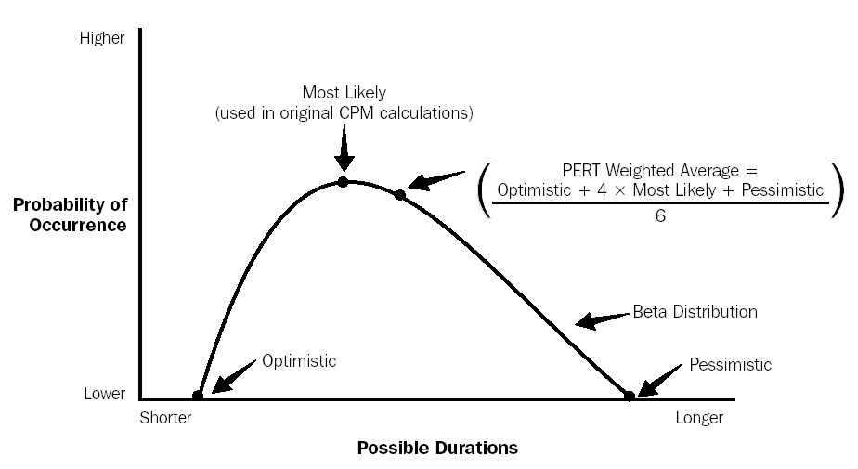
Pert Estimating Technique
Notes:
The PERT Chart, the Apollo space program developed the pert chart techniques. The techniques were used by the managers to track the relationship between various activities. The PERT diagram shows the activities to be conducted and the relationship between other activities.

Slide 38
Pert Estimate: Sample
Pessimistic = 12
Optimistic = 2
Most Likely = 5
Pert Estimate Formula: Pessimistic + (4 * Mostly Likely) + Optimistic /6
What is the Pert Estimate?

Slide 39
Developing the Schedule
Uses results of the other time management processes to determine the start and end date of the project
Ultimate goal is to create a realistic project schedule that provides a basis for monitoring project progress for the time dimension of the project
Important tools and techniques include Gantt charts, critical path analysis, critical chain scheduling, and PERT analysis

Slide 40
6.5 Develop Schedule
Inputs
1 Activity list
Tools & Techniques
1 Schedule network analysis
Outputs
1 Project Schedule
2 Activity attributes
3 Project schedule network diagrams
6 Activity duration estimates
9 Organizational Process assets
4 Activity resource requirements
8 Enterprise environmental factors
2 Schedule baseline
3 Schedule data
4 Project document updates
5 Resource calendars
7 Project scope statement
2 Critical path method
3 Critical chain method
4 Resource leveling
5 What if scenarios
6 Applying leads and lags
7 Schedule compression
8 Scheduling tool
Notes:
Process of analyzing activity sequences, durations, resource requirements, and schedule constraints to create the project schedule.
Schedule with planned dates for completing project activities.
Developing an acceptable project schedule is often an iterative process.
Determines the planned start and finish dates for project activities and milestones
Inputs
.1 activity list
.2 activity attributes
.3 project schedule network diagrams
.4 activity resource requirements
.5 resource calendars
.6 activity duration estimates
.7 project scope statement
.8 EEF
.9 OPA
Tools and Techniques
.1 schedule network analysis
Technique that generates the project schedule.
Analytical techniques, (CPM, CCM, what-if analysis and resource leveling to calculate the early and late start and finish dates for the uncompleted portions of project activities.
.2 critical path method
Calculates the theoretical early start and finish dates, and late start and finish dates, for all activities without regard for any resource limitations by performing a forward/backward pass analysis through the schedule network.
Calculated early start and finish dates, and late start and finish dates, may be affected by activity total float, which provides schedule flexibility and, may be positive, negative , or zero.
The schedule flexibility is measured by the positive difference between the early and late dates and it termed “total float”.
Schedule activities on a critical path are called “critical activities”.
A critical path is normally characterized by zero total float on the critical path.
Once the total float for a network path has been calculated then the free float – amount of time that an activity can be delayed without delaying the early start date of any immediate successor activity within the network path can be determined.
.3 critical chain method
“buffers”
Schedule network analysis technique that modifies the project schedule to account for limited resources.
Project schedule network diagram is built using duration estimates with required dependencies and defined constraints as inputs.
The resource-constrained critical path is known as the critical chain.
One buffer, placed at the end of the critical chain is known as the project buffer and protects the target finish date from slippage along the critical chain.
Additional buffers, known as feeding buffers” are placed at each point that a chain of dependent tasks not on the critical chain fees into the critical chain. Feeding buffers thus protect the critical chain from slippage along the feeding chains.
.4 resource leveling
Schedule network analysis technique applied to a schedule that has already been analyzed by the critical path method.
Resource leveling can be used when sharing or critical required resources are only available at certain items.
Resource leveling is necessary when resourced have been over-allocated, such as when resources s have been assigned to two or more activities during the same time period.
.5 what-if scenario analysis
Is performed using the schedule to compute the different scenarios.
The outcome of the what-if scenario analysis can be used to assess the feasibility of the project schedule under adverse conditions.
Most common technique is the Monte Carol Analysis – in which a distribution of possible activity durations is defined for each activity and used to calculate a distribution of possible outcome for the total project.
.6 applying leads and lags
Refinements applied during network analysis.
.7 schedule compression
Shortens the project schedule without changing the project scope.
Crashing
Cost and schedule tradeoffs are analyzed to determine how to obtain the greatest amount of compression for the least incremental cost.
Crashing does not always produce a viable alternative and may result in increased risk and/or cost.
Fast tracking
Phases or activities normally performed in sequence are performed in parallel.
Fast tracking may result in rework and increased risk.
Fast tracking only works if activities can be overlapped to shorten the duration.
.8 scheduling tool
Outputs
.1 project schedule
Includes a planned start date and planned finish date for each activity.
This process usually happens no later than completion of the project management plan.
Milestone charts
Similar to bar charts but only identfity the scheduled start or copetion of major deliverables and key external interfaces.
Bar charts
Bars representing activities, show activity start and end dates as well as expected durations.
Project schedule network diagrams
Activity date information, usually show both the project network logic and the project’s critical path schedule activities.
Can be presented in the activity-on-node diagram format, presented in an time-scaled schedule network diagram, logic bar chart
.2 schedule baseline
Specific version of the project schedule developed from the schedule network analysis. Component of the project management plan.
.3 schedule data
Includes at least the schedule milestones, schedule activities, activity attributes and documentation of all identified assumptions and constraints.
Resource requirements
Alternative schedules
Scheduling of contingency reserves
.4 project document updates
Activity resource requirements
Activity attributes – include any revised resource requirements
Calendar
Risk register – reflect opportunities or threats

Slide 41
Gantt Charts
Gantt charts provide a standard format for displaying project schedule information by listing project activities and their corresponding start and finish dates in a calendar format
Symbols include:
Black diamonds: milestones
Thick black bars: summary tasks
Lighter horizontal bars: durations of tasks
Arrows: dependencies between tasks

Slide 42
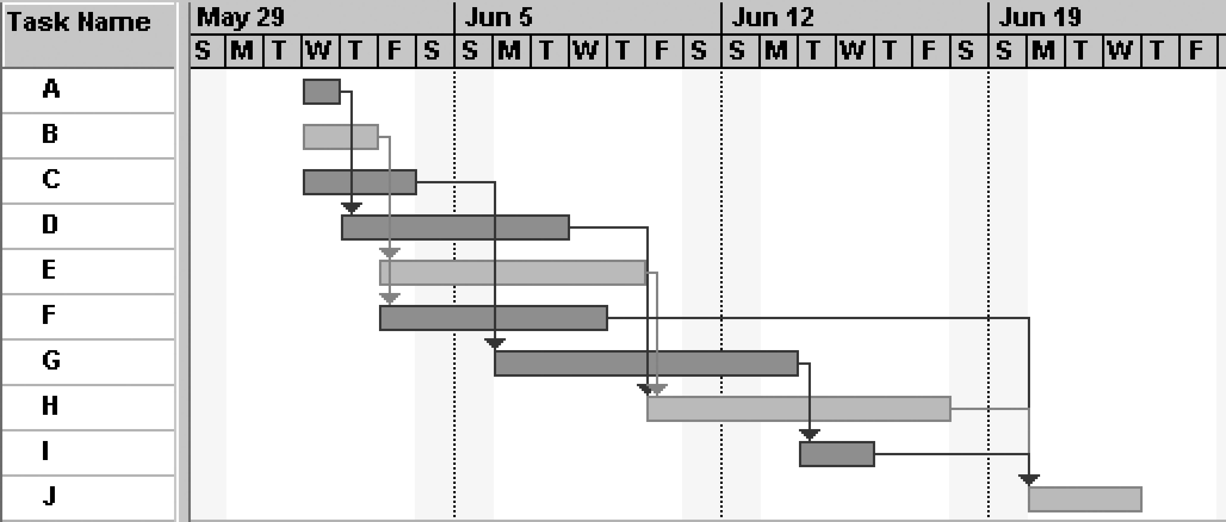
Gantt Chart for Project X
Gantt Chart for Project X
Note: Darker bars would be red in Project 2007 to represent critical tasks.

Slide 43
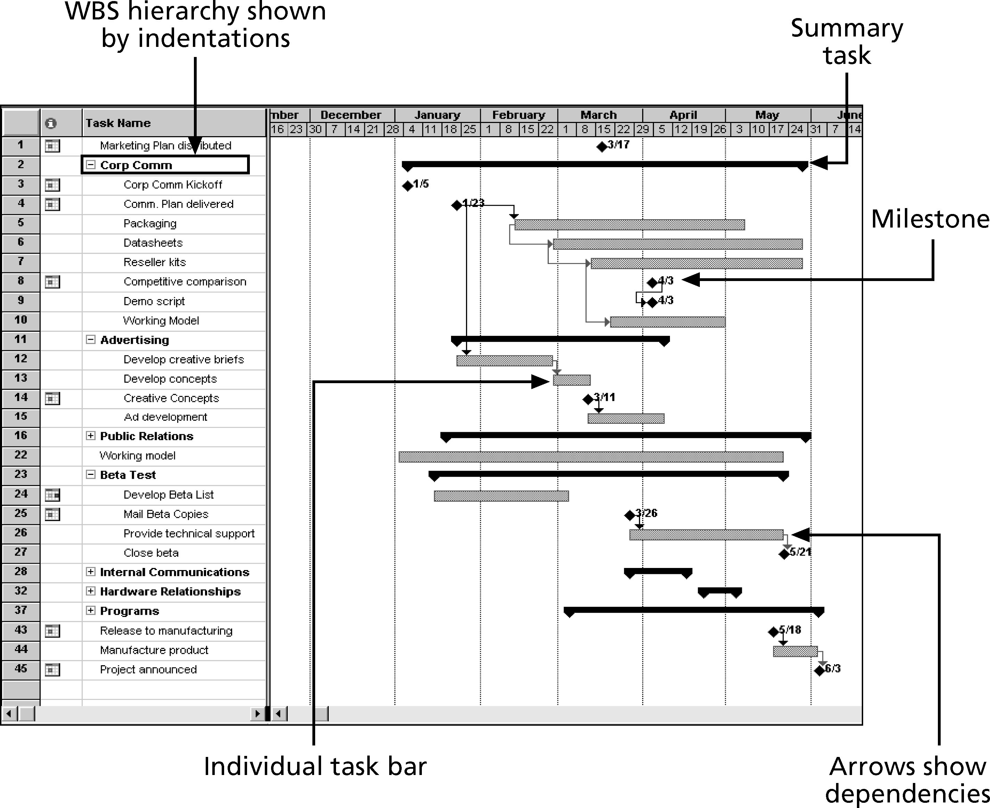
Gantt Chart for Software Launch Project

Slide 44
Adding Milestones to Gantt Charts
Many people like to focus on meeting milestones, especially for large projects
Milestones emphasize important events or accomplishments on projects
Normally create milestone by entering tasks with a zero duration, or you can mark any task as a milestone

Slide 45
SMART Criteria
Milestones should be:
Specific
Measurable
Assignable
Realistic
Time-framed

Slide 46
Best Practice
five key points of using project milestones include the following:
1. Define milestones early in the project and include them in the Gantt chart to provide a visual guide.
2. Keep milestones small and frequent.
3. The set of milestones must be all-encompassing.
4. Each milestone must be binary, meaning it is either complete or incomplete.
5. Carefully monitor the critical path.

Slide 47
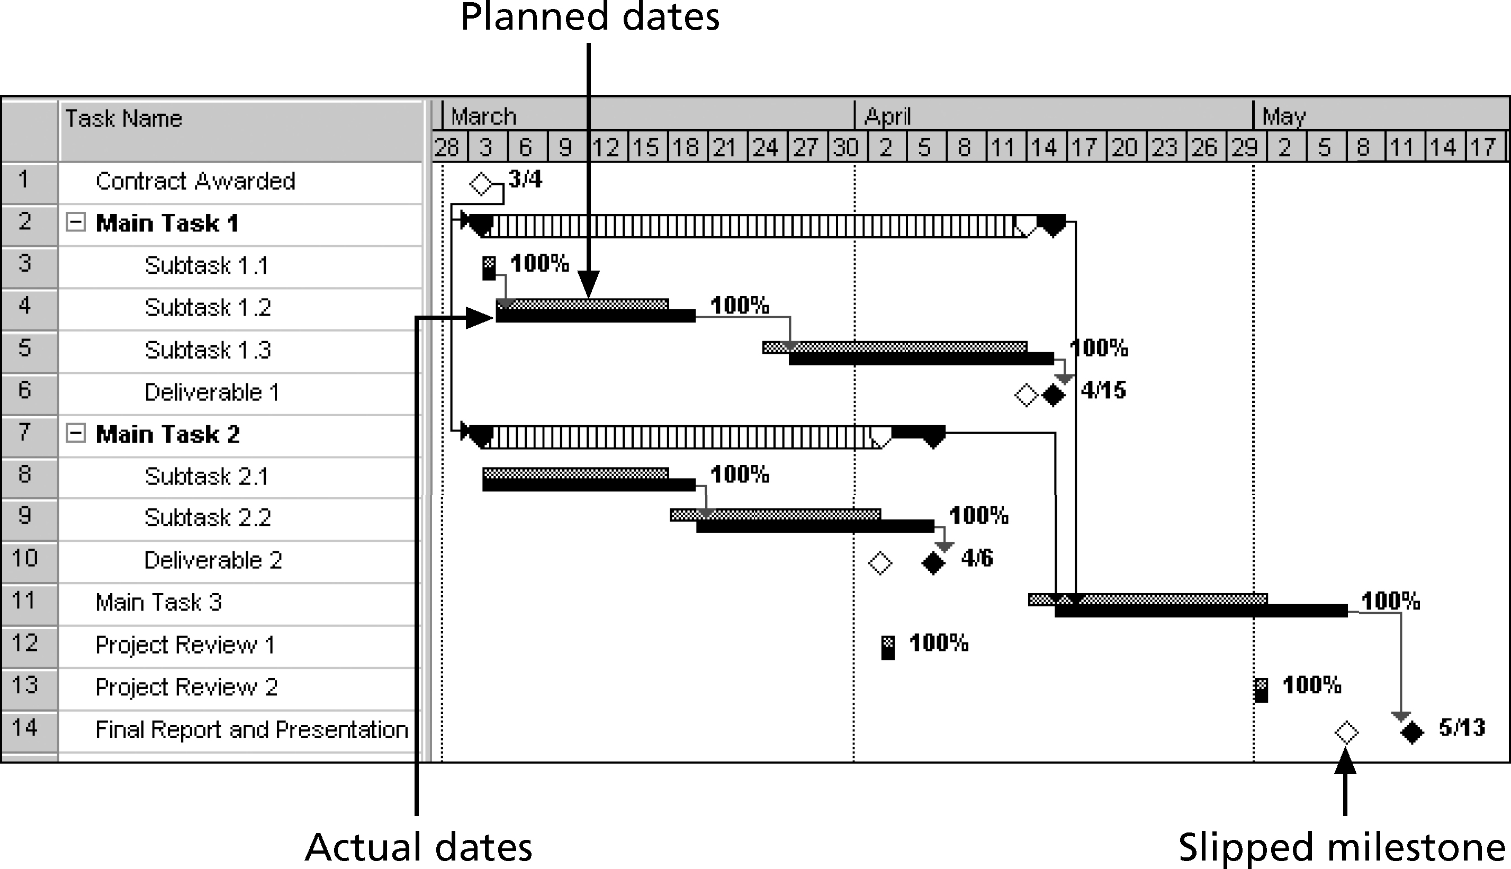
Tracking Gantt Chart

Slide 48
Critical Path Method (CPM)
CPM is a network diagramming technique used to predict total project duration
A critical path for a project is the series of activities that determines the earliest time by which the project can be completed
The critical path is the longest path through the network diagram and has the least amount of slack or float
Slack or float is the amount of time an activity may be delayed without delaying a succeeding activity or the project finish date

Slide 49
Critical Path Method (CPM)
The Critical Path method calculates the following:
Critical Path
Slack (or Float) is the amount of time that an activity can slip or be delayed without delaying the date of the project.
A forward pass is used to establish the earliest the activities can start and finish.
A backward pass is used to establish the latest the activities can start and finish.

Slide 50
Calculating the Critical Path
First develop a good network diagram
Add the duration estimates for all activities on each path through the network diagram
The longest path is the critical path
A project can have multiple critical paths
If one or more of the activities on the critical path takes longer than planned, the whole project schedule will slip unless the project manager takes corrective action

Slide 51
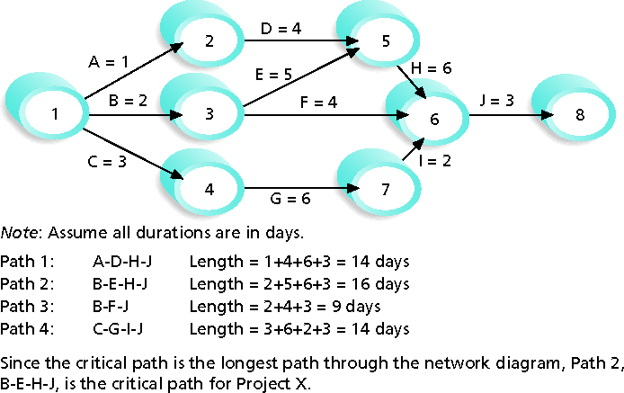
Determining the Critical Path for Project X

Slide 52
Network Diagram: Critical Path

Slide 53
Slack/Float Calculation
Late Finish - Early Finish (LF - EF)
Or
Late Start – Early Start (LS – ES)

Slide 54
FORWARD AND BACKWARD PASS CALCULATION
NODE SECTION
Notes:
Once you have established the earliest and latest event times you can now calculate the earliest and latest activity dates which are as follows:
EARLIEST START DATE (ES) – is the earliest date that a task start, it is the earliest event time of the event at the start of that project.
EARLIEST FINISH DATE (EF) – is the earliest date that a task can finish, it is the earliest event time of the event at the start of that project plus the duration of the project.
LATEST STATE DATE (LS) – is the latest date by which a task must start in order not to delay the project, it is calculated by deducting the task duration from the latest event time of the event at the finish of the project.
LATEST FINISH DATE (LF) – is the latest day by which a task should be finished, it is the latest event time of the event at the finish of the project.
Note: Activity or event or task(s) are interpreted as occurring at the end of the day. Also, note the start of the project is known as day “0”.

Slide 55
Critical Path Method (CPM)
Note:
Any activity that is on the critical path typically has zero slack, BUT there can be negative slack if the project is behind schedule.
A negative or positive Float can also exist.

Slide 56
Using the Critical Path to Shorten a Project Schedule
Three main techniques for shortening schedules
Shortening durations of critical activities/tasks by adding more resources or changing their scope
Crashing activities by obtaining the greatest amount of schedule compression for the least incremental cost
Fast tracking activities by doing them in parallel or overlapping them

Slide 57
Project Delivery: Normal
Notes:
In planning for project delivery in a normal pattern the Gantt chart will look like this

Slide 58
Project Delivery: Fast Track
Parallel tasks
Notes:
In fast tracking we look for any opportunity to do several items in parallel. This may change the duration of some tasks in order to provide resources to work on more than one item. The Critical path becomes more obvious in those items that cannot be compressed. No additional costs as the same number of resource hours were applied. Fast tracking can have an additional risk where any design adjustments requested during the construction phase may require more rework

Slide 59
Project Delivery: Crashing or Compressing a Project
More resources
Notes:
The crashing terminology refers to injecting any additional costs such as labour or special materials to shorten the end date of a project as much as possible. A crashed project Gantt chart may look like this:
In this example the Project Manager proposed additional resources and a change in the siding material to reduce the total elapse time. The additional costs were associated with overtime on the construction of forms and installation of mesh along with the snap siding materials applied.

Slide 60
6.6 Control Schedule
Project Time Management
Inputs
1 Project Management Plan
Tools & Techniques
1 Performance reviews
Outputs
1 Work performance measurements
2 Variance analysis
3 Project management software
4 Resource leveling
5 What if scenarios
6 Adjusting leads and lags
7 Schedule compression
8 Scheduling tool
4 Organizational Process assets
2 Project schedule
3 Work performance information
2 Organizational process assets updates
3 Change requests
4 Project management plan updates
5 Project document updates
Notes:
Monitoring the status of the project to update the project progress an manage changes to the schedule baseline
Schedule control is concerned with:
Current status
Factors that create schedule changes
Project schedule has changed
Actual changes
Inputs
.1 project management plan
The schedule management plan describes how the schedule will be managed and controlled. The schedule baseline is used to compare with actual results to determine if a change, corrective action or preventive action is necessary.
.2 project schedule
.3 work performance information
.4 OPA
Tools and Techniques
.1 performance reviews
Measure, compare, and analyze schedule performance such as actual start and finish dates, percent complete, and remaining duration for work in progress.
Comparing the amount of buffer remaining to the amount of buffer needed to protect the delivery date can help determine schedule status. Buffer can also help determine if corrective action is appropriate.
.2 variance analysis
Schedule performance measurements (SV, SPI) are used to assess the magnitude of variation to the original schedule baseline.
Total float variance is also an essential planning component evaluate project time performance.
.3 project management software
.4 resource leveling
Optimize the distribution of work among resources
.5 what-if scenario analysis
Review various scenarios to bring the schedule into alignment with the plan.
.6 adjusting leads and lags
Find ways to bring project activities that are behind into alignment with the plan.
.7 schedule compression
Find ways to bring project activities that are behind into alignment with the plan.
.8 scheduling tool
Outputs
.1 work performance measurements
the calculated SV and SPI values for the WBS components in particular the work packages and control accounts are documented and communicated to stakeholders
.2 OPA updates
Causes of variances
Corrective action chosen
Lessons learned
.3 change requires
Schedule variance analysis, along with review of progress reports, results of performance measures and modifications to the project schedule can result in change requests to the schedule baseline and/or to other components of the project management plan.
.4 project management plan updates
Schedule baseline
Schedule management plan
Cost baseline
.5 project document updates
Schedule data – net project schedule network diagrams may be developed to display approved remaining durations and modification to the work plan.
Project schedule

